Slide 1
Ramesh kanna G
DevOps Engineer

Slide 2
Medusa Backend deployment
What is medusa?
Medusa is a digital commerce platform with a built-in framework for customization.
What I did?
Dockerized the Medusa backend and deployed it on AWS ECS Fargate using Terraform and GitHub Actions for automated CI/CD with RDS integration.

Slide 3
Project OVERVIEW
Task
Design the IaC using Terraform to deploy the Medusa open source headless commerce platform backend, on Aws ECS with Fargate and set up CD pipeline using GitHub Actions.
TL;DS
“To deploy the Medusa backend using Docker on AWS ECS with fully automated infrastructure provisioning and CI/CD.”

Slide 4
Tech stacks
Open-source headless commerce platform used for building the backend service.
Medusa.js
Cloud platform used to host and deploy infrastructure and application services.
AWS
Infrastructure as Code (IaC) tool used to automate AWS resource provisioning.
Terraform
Source code management platform for version control and collaboration.
GitHub

Slide 5
Tech stacks
CI/CD tool used to automate build and deployment workflows.
GitHub Actions
Shell scripting language used to automate server setup and deployment tasks.
Bash
Containerization platform to package and run the Medusa application.
Docker
Isolated network environment for securely hosting AWS resources.
VPC

Slide 6
Tech stacks
AWS service used to manage user permissions and access.
IAM
Managed PostgreSQL database used by the Medusa backend.
RDS [PSQL]
Serverless container service used to deploy and run Docker containers.
ECS Fargate
Used to route traffic to ECS services based on URL paths.
ALB

Slide 7
Tech stacks
Monitoring and logging service to track application and infrastructure metrics.
CloudWatch
Scalable object storage used for storing static assets, files, or backups.
S3
Lightweight code editor used for writing and managing source code.
VS Code
Github Debug, Google, ChatGPT, Stack overflow, YouTube
Debugging Toolkit

Slide 8
prerequisites
MEDUSA BACKEND SETUP
NODE.js, YARN
GITHUB
GITHUB ACTION [CICD]
DOCKER
AWS
TERRAFORM
VPC, ALB
IAM, CLOUDWATCH
RDS
ECS, FARGATE
VS CODE [your wish]

Slide 9
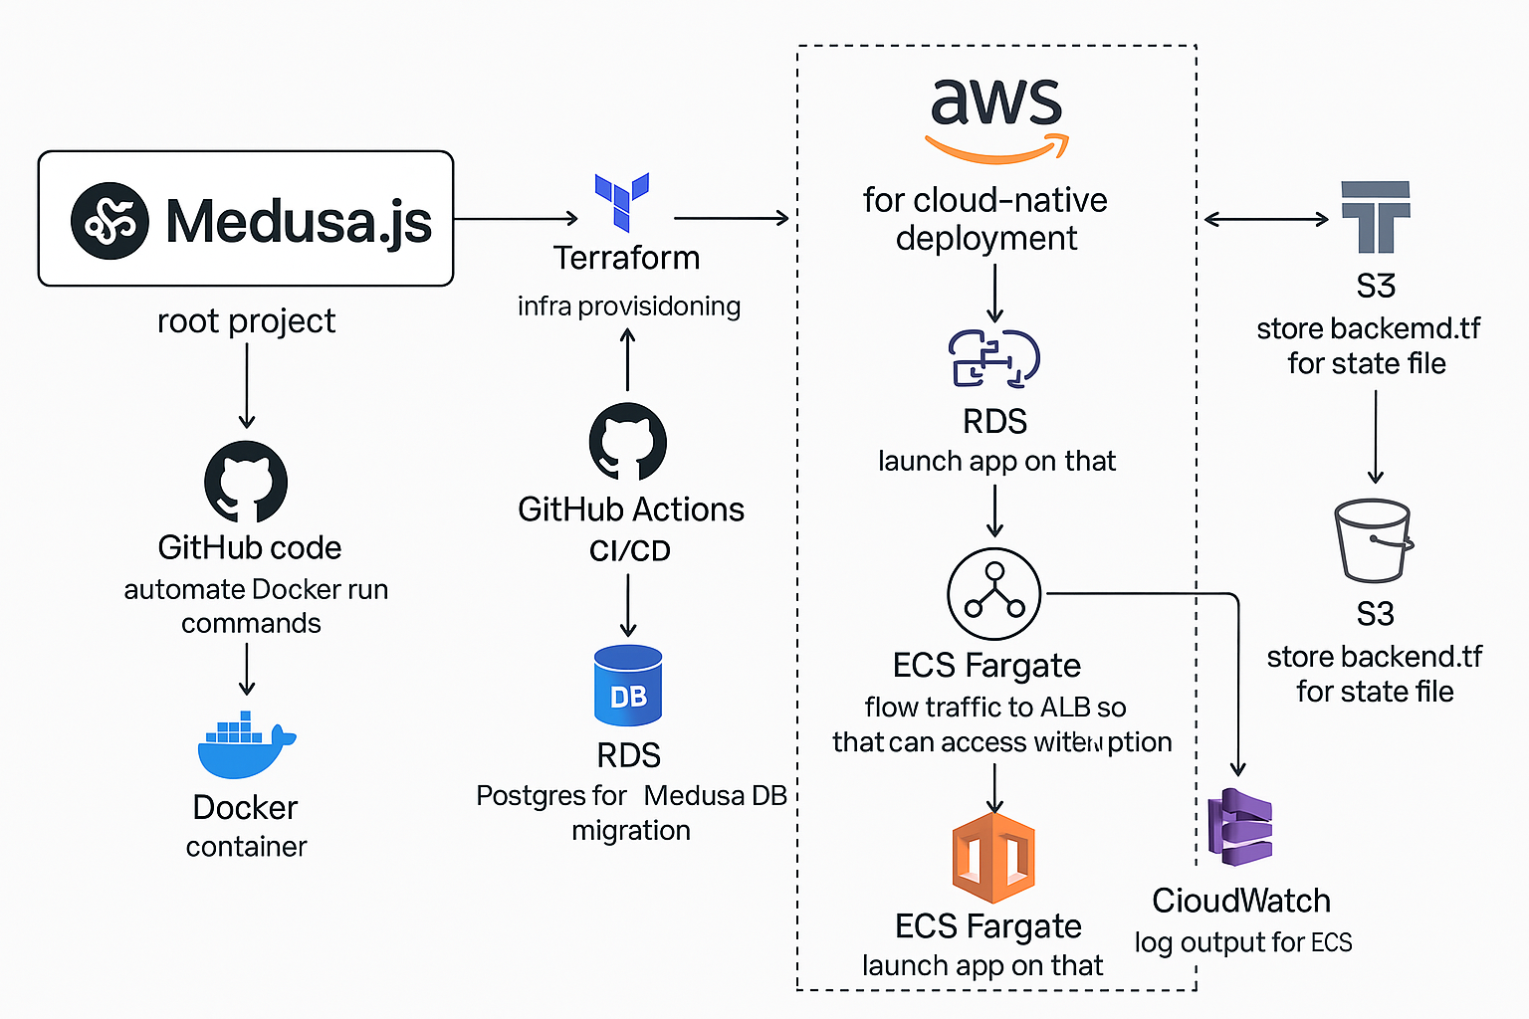
High-Level Architecture

Slide 10
Detailed Steps
10

Slide 11
ALB Setup
Purpose: Configure an ALB to route traffic to the Medusa backend running on ECS.
Key Components:
ALB:
Name: medusa-alb
Load Balancer Type: Application
Subnets: Public subnets for internet-facing access.
Security Group: Attached to medusa_sg.
ALB Target Group:
Port: 9000 (for Medusa backend)
Health Check: /app endpoint to verify service health.
ALB Listener:
Port: 80 (HTTP)
Action: Forwards traffic to medusa-tg target group.
Traffic Flow: The ALB receives HTTP traffic and forwards it to ECS tasks running Medusa backend through the target group.

Slide 12
VPC SETUP
Purpose: Create and configure a Virtual Private Cloud (VPC) with two public subnets and associated networking components for Medusa deployment.
Key Components:
VPC :
CIDR Block: 10.0.0.0/16
DNS Support: Enabled to allow instances to resolve domain names.
Public Subnets:
Subnets: public_subnet_1 and public_subnet_2CIDR
Blocks: 10.0.1.0/24 and 10.0.2.0/24
Availability Zones: us-east-1a, us-east-1b
Public IP on Launch: Enabled for direct internet access.
Internet Gateway:
Attached to: The medusa_vpc for external connectivity
Route Table :
Associates the public subnets to the route table, enabling external communication.
Traffic Flow: The VPC provides network isolation, while public subnets and route table configurations allow ECS instances and other services to communicate with the internet through the attached Internet Gateway.

Slide 13
RDS POSTGRES SETUP
Purpose: Configuring security groups to control inbound and outbound traffic for the ALB, ECS, and RDS resources.
Key Components:
RDS Subnet Group:
Selects 2 public subnets for the RDS instance to ensure high availability and fault tolerance.
RDS Instance:
Engine: PostgreSQL (version 17.4).
Instance Class: db.t3.micro (suitable for small workloads).
Allocated Storage: 20 GB (gp2 storage).
VPC Security Groups: Uses rds_sg for security.
Publicly Accessible: Yes, to allow internet connectivity.
IAM Authentication: Enabled for secure authentication.
Port: 5432 (default PostgreSQL port).
RDS Parameter Group:
Configures max_connections to 500, to optimize connection pooling.
Traffic Flow: ECS accesses the RDS PostgreSQL instance over port 5432 with the necessary security group rule, ensuring secure and controlled database communication.
Access the code here: https://github.com/RameshXT/medusa-backend-deploy.git
13

Slide 14
Security Groups Setup
Purpose: Configuring security groups to control inbound and outbound traffic for the ALB, ECS, and RDS resources.
Key Components:
ALB Security Group :
Inbound Rules:
HTTP (Port 80) – Public access.
HTTPS (Port 443) – Secure access.
SSH (Port 22) – For administrative access.
Outbound Rule: Allows all outbound traffic.
ECS Security Group:
Inbound Rule: Allows ECS container access from ALB on port 9000.
Outbound Rule: Allows all outbound traffic.
RDS Security Group:
Inbound Rule: Allows access to RDS PostgreSQL (Port 5432) from ECS.Outbound Rule: Allows all outbound traffic
Traffic Flow: ALB handles HTTP/HTTPS traffic from the internet, forwards it to ECS, which communicates with RDS for database access.

Slide 15
ECS SETUP
Purpose: ECS Cluster setup focusing on ECS, task definitions, CloudWatch logging, and ECS service configuration.
Key Components:
ECS Cluster: :
Cluster Name: medusa-cluster.
Task Definition:
Compatibility: Fargate
Resources: CPU (512), Memory (1024 MB)
Environment: DATABASE_URL (PostgreSQL connection), NODE_TLS_REJECT_UNAUTHORIZED (0)
Logs: CloudWatch (/ecs/medusa-server)ess.
CloudWatch Log Group:
Retention: 7 days
ECS Service:
Desired Count: 1Public
IP: Assigned to containers
Load Balancer: Port 9000, targets ECS service
Traffic Flow: User Request -> ALB (Ports 80, 443) -> ECS Task (Port 9000) -> ECS Container to RDS (Port 5432) -> ECS Logs to CloudWatch.

Slide 16
CD – GITHUB ACTIONS SETUP
Purpose: Automate Docker image build & deploy Medusa backend to AWS ECS using Terraform.
Key Components:
Code Checkout
Pulls code from master branch.
Docker Build & Push
Builds Docker image using GitHub Actions.
Tags image as: v1.0.${{GITHUB_RUN_NUMBER}}
Pushes image to Docker Hub.
Terraform Setup
Initializes and validates Terraform.
Applies infrastructure changes on AWS ECS Fargate.
Result
Seamless CI/CD workflow
Zero manual intervention
Easy rollback with version tags
Work Flow: Code pushed to GitHub triggers a pipeline that builds & pushes Docker image to Docker Hub. Terraform updates ECS with the new image and infra, deploying Medusa backend via AWS Fargate.
Access the code here: https://github.com/RameshXT/medusa-backend-deploy.git
16

Slide 17
Docker Image Optimization
5 minutes
1.06 GB
low
Build Time
Image Size
Performance
Before – dockerfile

Slide 18
Docker Image Optimization
1 minutes
154 GB
high
Build Time
Image Size
Performance
After – multi stage dockerfile

Slide 19
Demo
Once the Medusa backend is successfully deployed, it becomes ready for use.
You can interact with it through various interfaces such as the Admin Dashboard and APIs.
This enables full control over your ecommerce operations and custom integrations.

Slide 20
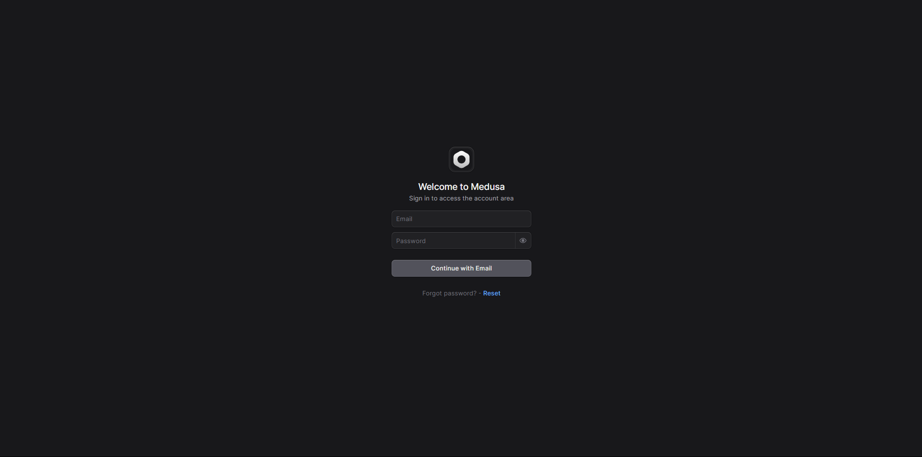

Slide 21
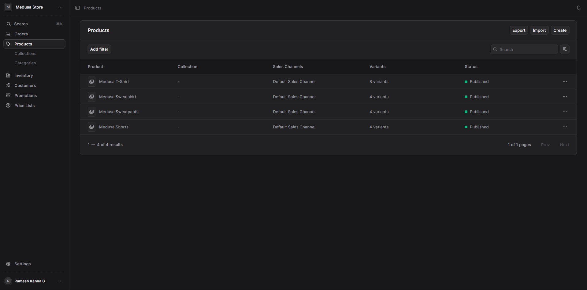

Slide 22
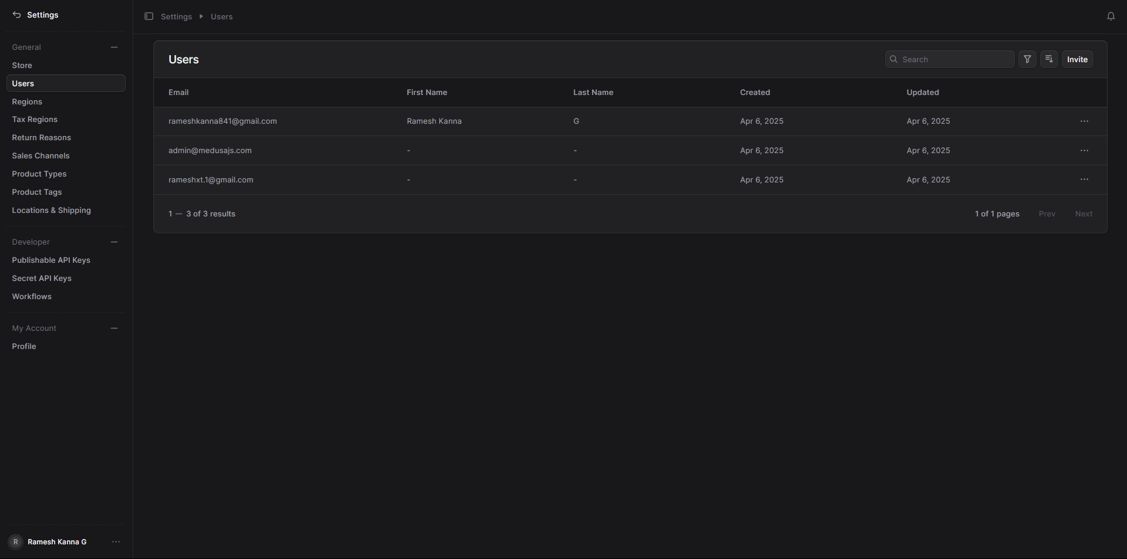

Slide 23
Conclusion
Successfully designed and deployed a scalable Medusa backend using Docker, Terraform, GitHub Actions, and AWS ECS (Fargate).
This project demonstrates a complete real-world CI/CD pipeline, Infrastructure as Code (IaC) practices, and cloud-native deployment, aligning with modern DevOps standards.

Slide 24
THANK YOU
Ramesh Kanna G​
+91 94424 03868
rameshkanna841@gmail.com
https://rameshxt.pages.dev

